Slide 1
HTML5 AND CSS3 FUNDAMENTALS UNIT 2.0

Slide 2
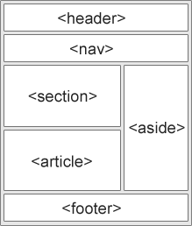
New Semantic Elements in HTML5
<article>
<aside>
<details>
<figcaption>
<figure>
<footer>
<header>
<main>
<mark>
<nav>
<section>
<summary>
<time>

Slide 3
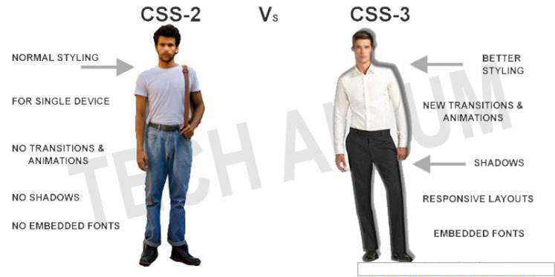
Introducing CSS3

Slide 4
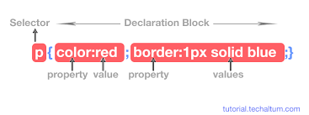
CSS3 Selectors

Slide 5
CSS3 Pseudo Class
A pseudo-class is used to define a special state of an element.
For example, it can be used to:
Style an element when a user mouses over it
Style visited and unvisited links differently
Style an element when it gets focus

Slide 6
CSS3 Pseudo Class Syntax
selector: pseudo-class { property: value; }
div: hover { background-color: blue; }

Slide 7
CSS3 Pseudo Element
A CSS pseudo-element is used to style specified parts of an element.
For example, it can be used to:
Style the first letter, or line, of an element
Insert content before, or after, the content of an element

Slide 8
CSS3 Pseudo Element Syntax
selector::pseudo-element { property: value; }
p::first-line { color: #ff0000; font-variant: small-caps; }

Slide 9
CSS3 3D TRANFORMS
CSS allows you to format your elements using 3D transformations
CSS 3D Transform Methods
rotateX()
rotateY()
rotateZ()

Slide 10
CSS3 3D Transform
#myDiv { -webkit-transform: rotateX(150deg); /* Safari */ transform: rotateX(150deg); /* Standard syntax */ }
<div id="myDiv">
This div element is rotated 150 degrees.
</div>

Slide 11
UNIT 2.0 ENDS HERE

